Slide 1
Adult Social Care
Workforce Data Set
(ASC-WDS)
Notes:
For info: This presentation is designed to give attendees a good understanding of what the Adult Social Care Workforce Data Set is, how it can benefit partners and providers and how the data makes an impact on the adult social care sector. It also aims to encourage sector influencers to help us promote ASC-WDS with providers in their area. It should take approximately 20-30 minutes. The intended audience is Local Authorities, ADASS, Commissioners, trade orgs, and other strategic stakeholders.

Slide 2
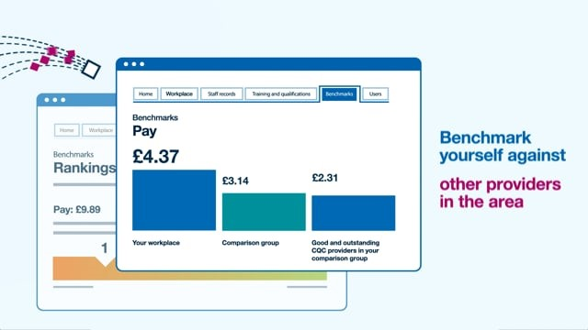
Discover the ASC-WDS
Take a look at the video https://bit.ly/2Q45Ww3
Notes:
We’ve created this short video to help you understand the benefits of using ASC-WDS and how the data within the system can be used by the Government and other stakeholders to make informed decisions about the care sector.
You can either play the embedded video or direct attendees to view it themselves/share with colleagues.

Slide 3
The Adult Social Care Workforce Data Set
ASC-WDS is a data collection service, commissioned and funded by the Department of Health and Social Care. It is the leading source of intelligence for the adult social care workforce.
It helps you to manage your team and provides crucial information to decision makers.
Notes:
If you played the video: So that was a whirlwind introduction to ASC-WDS, now let’s look at it in a little more detail…
The Adult Social Care Workforce Data Set (ASC-WDS) is a data collection service, commissioned and funded by the Department of Health and Social Care. It is the leading source of intelligence for the adult social care workforce.
We know that the adult social care sector is complex and fragmented and made up of thousands of different care providers. And, we know that the people who work in the sector are absolutely vital in terms of providing high quality care and support. So, understanding that workforce is so important for planning and decision making across the sector- and that’s what we’re trying to do with ASC-WDS- to build that understanding.
It helps providers to manage their teams and also provides crucial information to key decision makers such as Government, DHSC, CQC and local authorities.
It was previously known as the National Minimum Data Set for Social Care (NMDS-SC).

Slide 4
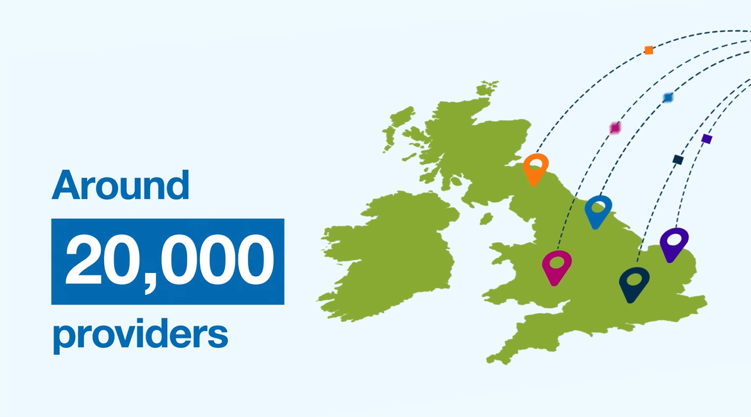


The Adult Social Care Workforce Data Set
1.5m people
1.62m filled posts
165,000 vacancies
480,000 more jobs by 2035
Our crucial intelligence is used by:
Notes:
ASC-WDS means that all care providers can make their voice heard. Around 20,000 providers already have an account and are providing us with crucial information, including almost two thirds of all Outstanding rated providers.
The data from those providers tells us…
There are one point five million people working in adult social care.
Those people do 1.62 million jobs
That there one hundred and sixty-five thousand vacancies across the sector on any given day.
It also tells us that we’ll need four hundred and eighty thousand more jobs by 20-35 to keep up with an aging population
The data we collect is the leading source of intelligence for the adult social care workforce. It provides crucial information to decision makers such as government, the Department of Health and Social Care, the Care Quality Commission, Health Education England and local authorities.
So by contributing to ASC-WDS, you can help us build a detailed picture of the sector and highlight the areas that most need support.

Slide 5
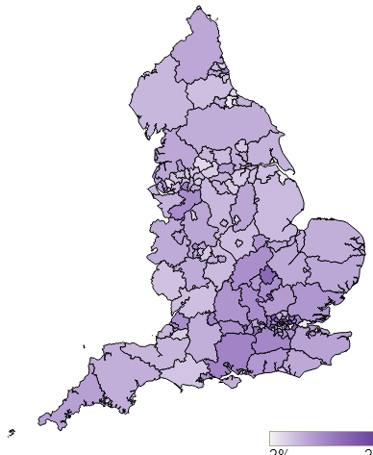
How can you use the ASC-WDS data?
You can use the anonymised ASC-WDS data to gain insight on
the local labour market
future demand for care services in your areas
trends and patterns in workforce issues such as turnover and pay rates.
Data can be used to inform workforce planning and can be integrated into your existing platforms.
Notes:
Key stakeholders use the data to gain insight on the local labour market, future demand for care services in their areas, and trends and patterns in workforce issues such as turnover and pay rates. The data can be used to inform workforce planning and the support you offer to the sector. For a fee, it can also be integrated into your existing platforms- For example, we integrated the data with the London ADASS Market Insight Tool, which brings together several sources of data across London to inform their commissioners.

Slide 6
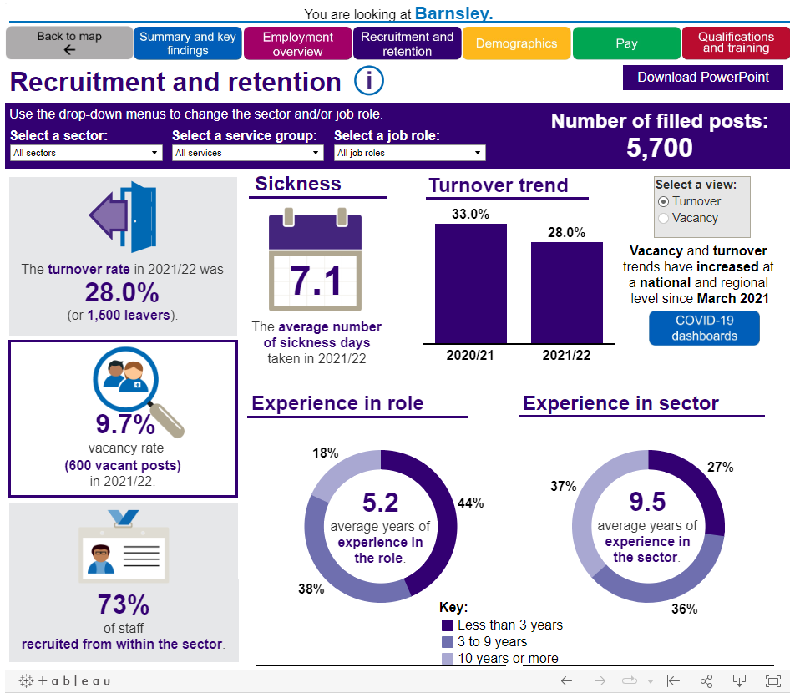
Data example
Notes:
Please feel free to replace with a screenshot from your local area, you may want to draw attention to some of the key stats in your area: https://www.skillsforcare.org.uk/adult-social-care-workforce-data/Workforce-intelligence/publications/local-information/My-local-authority-area.aspx
Here’s an example of some of the workforce data that you can find on the Skills for Care website. It is presented in ways which are easy to interpret.
You can view information on a national level, regionally, or by local authority or ICS area.

Slide 7
“
“The datasets workforce statistics have provided us with oversight concerning the potential gap that will be left in our workforce due to retirement over the next decade. This has had a significant impact... We have stepped up our engagement in local recruitment and tailored our initiatives in a way in which is receptive to our new knowledge of recruitment and demographics... We have recognised a need to target younger audiences in the job market and have linked with local media companies to build modern promotional material to recruit from younger age groups. The data concerning age has also stimulated us to approach local educational institutions and provide them with an account of what delegates from our market would like to see in their curriculum so that new care workers from younger age groups are equipped with the correct skills.”
Harry Palmer, Project and Development Officer at North Lincolnshire council
Notes:
As an example of how local authorities use this intelligence, North Lincolnshire Council used ASC-WDS data to inform their approach to recruitment, following the identification of a gap due to expected retirement across the sector.

Slide 8

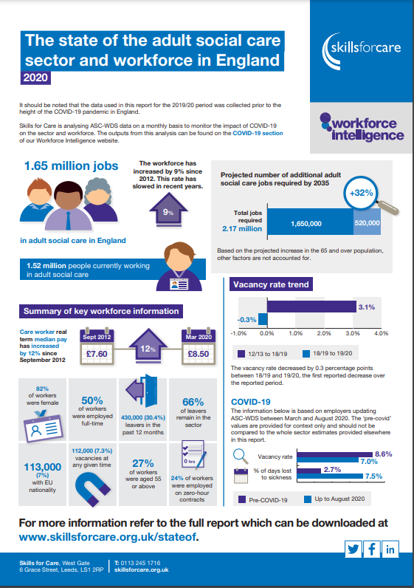
Data and publications
Information on key topics like recruitment and retention, registered nurses or apprenticeships.
State of adult social care report
https://www.skillsforcare.org.uk/workforceintelligence
Notes:
We use the information collected in the Adult Social Care Workforce Data Set (ASC-WDS) to create robust estimates for the size of the whole adult social care sector and characteristics of the workforce. We add insight and interpretation via our workforce intelligence publications.
Our annual ‘State of the adult social care sector and workforce’ report is published each Autumn and is an important resource for the sector. Our analysis allows us to see patterns over time and these trends allow us to see the impact of policy changes and economic shifts, which, in turn help to inform our longer-term thinking.
A stakeholder list of interested parliamentarians and sector bodies are invited to the launch of the State Of report each year.

Slide 9





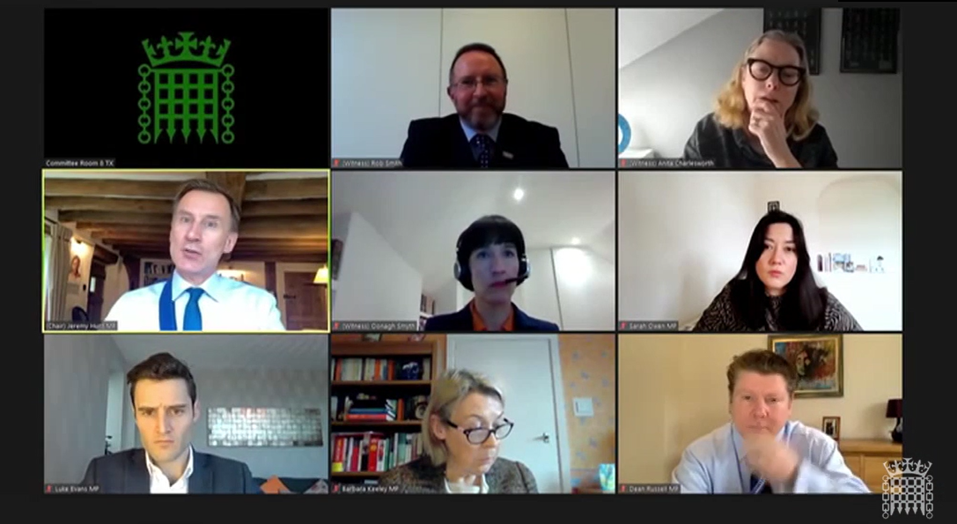
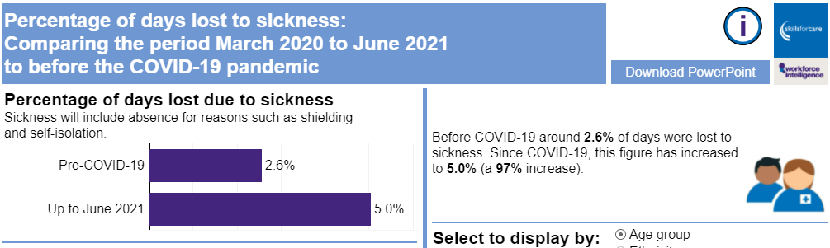
Informing policy and planning
Notes:
The information providers give us is used to provide intelligence and evidence to key decision makers in the sector, here’s a few examples of what that actually means…
We’ve provided data to government to inform their thinking on things like:
Last summer (2022) DHSC asked us to add some new questions to the service (Qs are about recruitment, advertising and staff benefits etc). They'll use the responses to measure the impact of the social care reform initiatives that they’re working on from the latest White Paper. So it’s going to be crucial going forward to measure the success of what they’re proposing to do to help face the challenges in the sector at the moment.
The Migration Advisory Committee’s review of the impact of ending freedom of movement, data provided by Skills for Care was integral in highlighting the important role that non-British workers play in our social care sector
Our analysts have recently done some work on international recruitment for the secretary of state – to help them understand the link between the high international recruitment inflows and the vacancy rate in the sector

Slide 10
Bespoke reports
We offer tailored support to help with:
  Future workforce forecasting
  Overviews of the sector and workforce at a local level
  Focused analysis on particular parts of the sector or workforce such as specific service types or job roles.
  Economic contribution of
  social care in your area
  Impact of national living
  wage in your area
Notes:
We can offer tailored support to help you with future workforce forecasting, overviews of the sector and workforce at a local level or focus on particular parts of the sector or workforce at a local level, for example:
specific service areas e.g. domiciliary care or residential care
the workforce providing care and support to a specific group of people, e.g. people with dementia or learning disabilities
specific job roles, e.g. registered nurses, care workers or social workers.
We can also provide reports on the Economic contribution of social care in your area and the Impact of national living wage in your area.

Slide 11
The picture in Barnsley
Regional CQC coverage
48.8%
Your CQC coverage
56.1%
-7.9%
in the last three months
National ranking
23 of 152
Notes:
Use this slide if speaking to LA or similar, otherwise hide.
Please replace with coverage stats from the appropriate area or region: https://app.powerbi.com/groups/me/reports/9f1b4814-c26b-4dd5-9966-d7ccf3419ebe/ReportSection098329ae6e5ae5bb8393?ctid=5c317017-415d-43e6-ada1-7668f9ad3f9f
So this is the current lay of the land in terms of providers using ASC-WDS in your area.
You can see that our overall coverage is [56.1]%... This means that [56.1]% of CQC registered providers in [AREA] have an ASC-WDS account. In comparison to the regional average in [Yorkshire and the Humber] of [48.8]%, this puts [AREA] at a ranking of [23] out of all 152 local authorities.
Over the last three months, there has been a [7.9]% increase/decrease in coverage.

Slide 12
The picture in Yorkshire & Humber
Your CQC coverage
48.8%
National CQC coverage
45.5%
National ranking
3 of 9
Spread across LAs
33.3% - 63.3%
Notes:
Use this slide if speaking to Regional leads (CQC, ADASS) or similar, otherwise hide.
Please replace with coverage stats from the appropriate area or region: https://app.powerbi.com/groups/me/reports/9f1b4814-c26b-4dd5-9966-d7ccf3419ebe/ReportSection098329ae6e5ae5bb8393?ctid=5c317017-415d-43e6-ada1-7668f9ad3f9f
So this is the current lay of the land in terms of providers using ASC-WDS in your area.
You can see that our overall coverage is [48.8]%... This means that [48.8]% of CQC registered providers in [AREA] have an ASC-WDS account. In comparison to the national average of [45.5]%, this puts [AREA] at a ranking of [3rd] out of all 9 regions.
There is also quite a disparity across [AREA] with coverage as low as [33.3]% in one area. [7] local authority areas have under 50% and the remaining [8] areas are at 50% or above.

Slide 13
Why should you encourage providers to use ASC-WDS?
Access to higher levels of valid workforce data will help you plan, shape and commission the workforce in your area
There are great benefits to the providers too
Notes:
We use data collected by the ASC-WDS to create workforce models that, in turn, allow for estimates of the whole adult social care workforce to be produced. Our methodology allows the analysis to be representative of all adult social care workers, even if the ASC-WDS has uneven levels of data coverage. We ensure the data has been through rigorous quality checks before analysis and have confidence in our estimates.
However, access to higher levels of valid and reliable workforce data will help you to monitor the quality of services, plan, shape and commission the workforce in your area. The data can support you in your key strategic role to meet the health and social care needs of the local population.
The service also benefits users…

Slide 14
Benefits to providers
Funding for training staff
Safe and free storage of staff records
Manage training records
Benchmark their workplace
Access the Skills for Care bundle
offer
Their data makes an impact and contributes to the voice of the sector
Notes:
So what are the benefits of ASC-WDS for providers? Well…
They can gain access to funding for training their staff via the Workforce development fund or Essential training fund. The Workforce development fund allows providers to claim back money towards the costs of workers completing a broad range of adult social care qualifications, learning programmes and digital learning modules. For example, it could fund a Level 2 certificate in Dementia Care or a Level 5 diploma in Leadership and Management for Adult Care.
The system provides safe and free storage of staff records and can help to manage your training records. Employers can decide what training is mandatory for each job role and get alerts when training is about to expire.
Users can benchmark their workplace against other providers in the area, for metrics like pay, turnover rates or staff sickness. At the moment this is only available to some types of providers, but we’re working to extend this to others. [Currently: CQC regulated care homes with nursing, care only homes and domiciliary care providers]
They’ll also get our new ASC-WDS Benefits Bundle offering discounts on products and services from Skills for Care and our Endorsed providers..
Finally, we know that the adult social care sector faces many challenges. With the data providers give us in ASC-WDS, they’re able to provide government and policy makers with a true picture of the sector and highlight the areas that most need support. ASC-WDS means that all care providers can make their voice heard.

Slide 15
“
“The system is great for tracking my staff training. I can see at-a-glance when training is missing or expiring… the service allows me to gather information to inform policies and procedures and inductions.” Paddy Turner, Training Manager and Activities Co-ordinator, Care Matters (SE)
”
“The benchmarking function is great for discussing aims and objectives for managers and their service such as monitoring and improving staff turnover, management of staff absence, or increasing percentage of staff with qualifications relevant to their role..” Marisa Spice, Learning & Development Manager, Nellsar Ltd.
Notes:
Here’s what some care providers are saying about how they use the system…
Source: https://www.skillsforcare.org.uk/About/Blog/Blog/A-look-at-how-social-care-managers-use-Skills-for-Care's-ASC-WDS.aspx

Slide 16
How can you encourage providers to use ASC-WDS?
Find out who has an account in your area
Consider making it contractual
Raise awareness and encourage the use of ASC-WDS as best practice
Email templates and presentation slides are available
Identify someone who can lead
on intelligence gathering and
analysis
Spread the word on how you use
ASC-WDS data to benefit the
providers in your area
Notes:
This slide is for local authorities only- delete if presenting to a different audience
Your Skills for Care Locality manager can provide you with a list of providers who do/do not have an ASC-WDS account in your area.
Some local authorities require providers in their area to have an up-to-date ASC-WDS account as a condition of their contracts.
Even if you don’t wish to make it a contractual obligation, your support and authority can help us to encourage social care employers to use the service. We have email templates and presentation slides which can be shared to help you get the message out. www.skillsforcare.org.uk/workforce-intelligence-sector-bodies
You could identify someone who can lead on intelligence gathering and analysis. They might already provide information or guidance to citizens, families or the public, collect figures/statistics and analyse data or support the completion of Adult Social Care- Workforce Data Set.
It will encourage providers to use ASC-WDS if they understand how you use the data to benefit them. For example, commissioners being able to identify recruitment issues and trends means they’re able to offer more tailored support and target resources where they’re really needed

Slide 17
How can you encourage providers to use ASC-WDS?
Raise awareness and encourage the use of ASC-WDS as best practice
Email templates and presentation slides are available
Spread the word on how you use
ASC-WDS data to benefit the
providers in your area
Notes:
This slide is for ICSs, ADASS, Care associations etc- Delete if not appropriate.
Your support and authority can help us to encourage social care employers to use the service. We have email templates and presentation slides which can be shared to help you get the message out.
It will encourage providers to use ASC-WDS if they understand how you use the data to benefit them. For example, workforce leads being able to identify recruitment issues and trends means they’re able to offer more tailored support and target resources where they’re really needed

Slide 18
Want to know more?
The Adult Social Care Workforce Data Set
www.skillsforcare.org.uk/workforce-intelligence-sector-bodies
Skills for Care’s Workforce Intelligence
www.skillsforcare.org.uk/WorkforceIntelligence
Or contact [Insert presenter name]
T. [insert phone number]
E. [insert email address]
Notes:
For more information about The Adult Social Care Workforce Data Set, go to www.skillsforcare.org.uk/ASCWDS
If you want to investigate the data we publish and learn more about how we can offer you bespoke analysis, take a look at www.skillsforcare.org.uk/WorkforceIntelligence
And of course if you have any questions, you can contact me at…

Slide 19
FAQs
How does ASC-WDS differ from the Capacity Tracker?
  ASC-WDS tracks detailed information about adult social employers and their workforce. Capacity tracker focuses on COVID-19 specific pressures.
What kind of coverage does ASC-WDS have?
  Approximately half of the workforce are recorded in the ASC-WDS. Skills for Care use this data, and data from other sources, to make representative estimates about the whole sector.
Is the data shown in real time?
  The majority of workforce statistics do not change quickly and therefore annual reporting is sufficient. Metrics which can change quickly are tracked on a monthly basis via our trackers.
Notes:
You can keep this slide hidden and use the answers as needed.
How does ASC-WDS differ from the Capacity Tracker?
The Capacity Tracker was initially developed to make the vacancies across providers more visible so that hospitals and system discharge services can quickly identify vacancies and improve the time it takes to discharge an individual into a care setting.
Since then, it has broadened to enable information to be collected on a wide range of relevant topics, including some workforce numbers. Its current focus is on Covid-specific pressures. By allowing real-time updating of data, it enables Government, NHSE systems and Local Authorities to monitor the changing pandemic situation and provides them with the detailed and timely information they need to plan a speedy policy response to emerging issues. In return it gives providers a quick and direct way to raise urgent needs or capacity issues.
Skills for Care’s ASC-WDS collects much more detailed workforce information and has done so since 2006. It really helps Government and others to understand long-term employer and workforce issues and trends, and provides evidence to support a wide range of workforce planning and investment decisions. An ASC-WDS account also gives users real benefits such as training and qualifications tools, benchmarking information and access to the Workforce Development Fund.
The Capacity Tracker and Skills for Care teams meet monthly so that we can try to minimise any duplication between the two data collection services.
What kind of coverage does ASC-WDS have?
Approximately half of the workforce are recorded in the ASC-WDS. This coverage varies by care service, job role and geographical area.
For the past seven years the Adult Social Care Workforce Data Set has been the adult workforce data return for local authorities. In 2020, for the eighth year in a row, all 151 local authorities in England met the criteria of a full return for people working in their adult social services departments.
Skills for Care estimates that there were 38,000 care establishments providing or organising adult social care in England in 2019/20, around 25,800 of these services were CQC regulated. In 2021, the ASC-WDS had around half coverage of all CQC regulated social care establishments they had completed around 580,000 worker records between them (out of a total population of around 1.1 million workers employed by CQC regulated employers).
Is the data shown in real time?
The majority of workforce statistics do not change quickly and therefore annual reporting is sufficient (such as demographics qualifications etc..).The data is collected for analysis at the end of March each year, with high level information published in June and our analysis and predictions released in September.
The exception is our monthly trackers for key workforce measures relevant to the COVID-19 which is unweighted data and may only reflect the characteristics of those who updated their ASC-WDS information.

